Slide 1

Irem Nasir
Graduation Project
15/05/2020

Slide 2
Notes:
Anyone knows the job title?
Has no formal education in medicine, let alone in natural sciences, yet he doesn’t abstain himself from giving medical advice

Slide 3
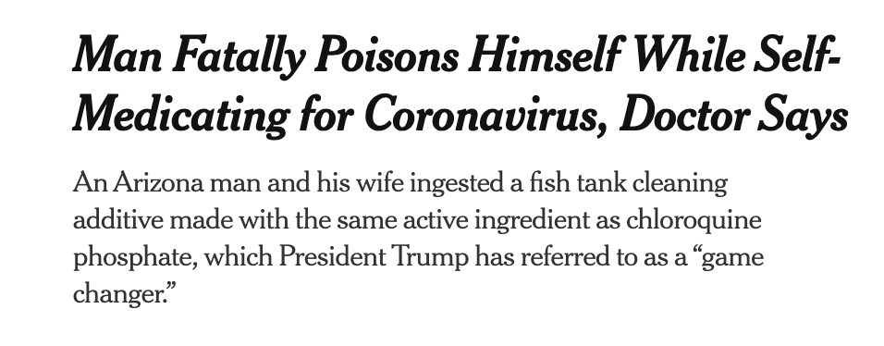
Sources: Twitter, The New York Times
Notes:
Two antimalarial drugs
The consequences were sad..

Slide 4
Sources: Time, The New York Times
Notes:
… but how do you reach scientific facts?
1- Ask a scientist.
2- Read papers & do both.

Slide 5
How to reach scientific facts?
Notes:
Glam journal from my field. No one has this much of money especially if you want to look up one article.().
Results are also not available immediately – for a journal of this tier, it usually takes a year after the paper is written, so normally the research had been completed a lot earlier, the field has moved on
They also charge the authors for submission

Slide 6

bioRXiv
Sever et.al., “bioRXiv: the preprint server for biology”, 2019, bioRXiv
Notes:
bioRXiv comes into the picture. Lets watch their own movie
Past 5 years, the number of papers posted increased exponentially
They do not have a recommender but lets take a look at how their architecture looks like

Slide 7
bioRXiv
Sever et.al., “bioRXiv: the preprint server for biology”, 2019, bioRXiv
Notes:
No recommender available!

Slide 8
bioReco
Extract: Abstracts
Transform: NER by sciSpacy
Load: Pickle
Recommendation App
“bioRXiv”
Recommendations based on similarity between articles
Built via Flask App
USER INPUT:
doi/keywords
Article category
OUTPUT:
Collection of articles w/ meta & links
bioRXiv
Articles from 2015 to date
Abstracts
doi
Meta
Mongo DB
Category Specific
Entity – Article Matrix
 | Entity1 | Entity 2 | Entity .. | Entity n
A 1 | 3 | 0 | 0 | 1
A 2 | 1 | 0 | 0 | 0
A .. | 0 | 0 | 2 | 1
A n | 0 | 1 | 0 | 0

Slide 9
Recommender Module
Recommender Performance
Inherently hard to evaluate
bioRXiv to rescue:
Existing version/submission corrections appear as top recommendations
Article-based collaborative filtering:
NER on abstracts by scisPacy biomedical model
“Article-article” similarity matrix
Adjusted score with # overlapping entities
Filter by 3 or more common entities

Slide 10

Acknowledgements
Best instructors ever!
Awesome cohort members (Gesa, Amirali, Juan)
SPICED office staff
Family
Source: spiced-academy.com

